Slide 1

HN
HE Induction

Slide 2
4 steps to success
KNOW:
HE academic calendar
The Learner Engagement process/opportunities
The Academic regulation
Understand the process for mitigation/extension request
DO:
Complete all your work and hand in on time
Speak to staff if you are falling behind or experiencing difficulties
Set dates in your diary for the student engagement meetings
Ask questions
SHOW:
You can work to the very best of you ability and get the grade your deserve – track your progress using Pro-portal
IMPROVE:
Use the feedback your given to help improve the quality of your work

Slide 3
HE Terminology
SSLC –Students and Staff Liaison Committee meeting – these are very formal student and tutor rep meetings – formally documented
Assessment/Exam Board meeting - Meeting that finalises and presents student grades and decides progression onto the next year – formally documented.

Slide 4
Cont.
Extensions (short and long term)- students can request 10 day or up to 6 month extension to a hand in date. Each unit must be listed if there is more than one due in. Must be in advance and will require evidence.
Mitigation –to be submitted prior to hand in, will require evidence.
QAA - Quality Assurance Agency
See Becky – bjones@harlow-college.ac.uk

Slide 5
Assessment Rules
Rules on how to submit work for assessment –are on Qube:
By 2p.m.
With the receipt pre-print and completed
In a plastic wallet
To central admin

Slide 6
Academic/Assessment Regulations
HN’s : On our Website–You need to be aware of these rules. These are the overall set of rules all staff and students must adhere to.
This is the first source of information for any academic concern are have.
If you wish to request an extension or mitigation please visit the qube page and complete the forms and email over to Becky.

Slide 7
Student Advisors
We help with any academic matters, academic offenses, extension requests, mitigations etc requests etc
Becky Jones – bjones@harlow-college.ac.uk
01279 868034
All our HE policies can be found on our website here: https://www.harlow-college.ac.uk/about/policies/student-policies

Slide 8
Student Engagement
What does this mean?
What do we currently do?

Slide 9
Student Engagement cycle

Slide 10
Full circle of Student Engagement
Team/Academy level:
Student engagement activities (learner voice & MES)
Informs a need for change
Implement change
Feedback to students
Evidenced through meeting minutes, SAR updates and learner voice posters
Institutional level:
Student engagement activities (SSLC and NSS/Pearson survey UKES)
Informs a need for change
Action for QIP to address
Evidence through SSLC minutes, QIP actions/SAR and feedback posters

Slide 11
SSLC dates
November 11th – 3.00-4.00p.m. (Wednesday)
March 23rd– 3.00-4.00p.m. (Tuesday)
We need you!
Students reps need to be present from each course, along with course tutors and managers
Formal agenda and minutes will be circulated
Each course and year needs to elect 1 or 2 reps.
This is different from the Ambassadors Scheme – applies to HE as well. Ambassadors are rewarded through a scheme of online vouchers. You can be both a Rep and am Ambassador!

Slide 12
Communication policy
Harlow College will communicate to you via your Harlow college email.
E.g. psn@ harlowcollege.onmicrosoft.com
You will require a temporary password to set this up.

Slide 13
Personal Tutor and 121’s
HE students need a personal tutor too!
You should have 121 meeting with your personal tutor at least twice a semester .
You may have group tutorial also.
A record of the 121 meeting is documented on pro-portal so you can access it.

Slide 14
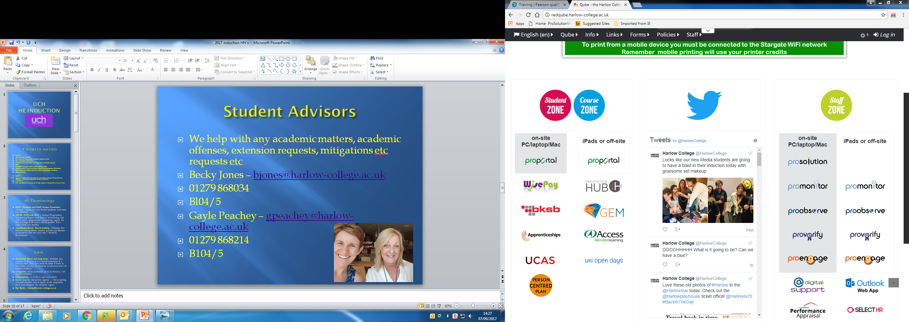
HE info on qube:
Qube
HE icon
HN’s icon or a UCH icon
All policy documents, Assessment regs, procedures are located here.

Slide 15
…if you are not satisfied
If our services falls below expectation that are a number of ways to try to resolve this, relevant information is on our website:
1. use your course Reps to raise the issue initially
2. Use the college formal complaints processes if the issues remains unresolved
3. If this outcomes is not fir you can appeal to the Office of Independent adjudicator once you have exhausted the college internal processes. You will require evidence that you have completed this processes first.
https://www.oiahe.org.uk/
4. for more generalised issues students can make a ‘notifications’ to the Office for students:
https://www.officeforstudents.org.uk/publications/office-for-students-notifications/

Slide 16

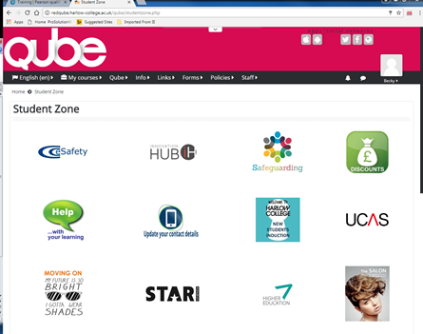
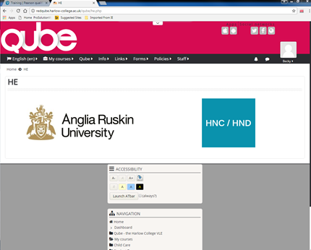
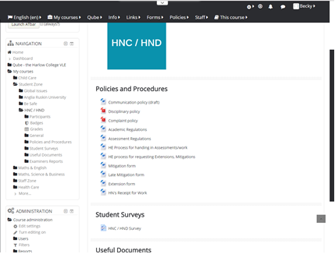

Slide 17

HN Global
It is a requirement that you sign up to HN global, this is your link to all the Pearson resources and the wider HN community. E Books, links to top –up Degree courses and other learning materials can be found here. Visit to create an account:
https://hnglobal.highernationals.com/

Slide 18
Good Luck
…..not sure , please just ask!

